Slide 1
End-to-End Reinforcement Learning of a CNN to achieve an autonomous driving agent resilient to light changes
Master‘s Thesis
Leipzig, 05.12.2023
Georg Schneeberger
Supervisor:
Dr. Thomas Burghardt
Notes:
Mention the thesis is still in work

Slide 2
Outline
Previous Work at the ScaDS.AI
Autonomous Driving Task
Research Questions
Related Work
Implementation
Experimentation
Evaluation
Conclusion

Slide 3
Previous Work at the scads
Master‘s Thesis

Slide 4
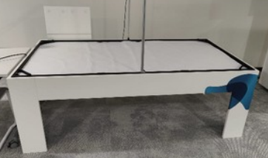
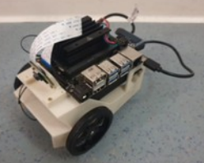
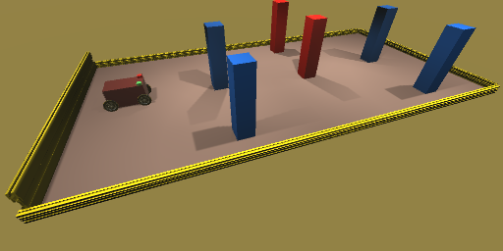
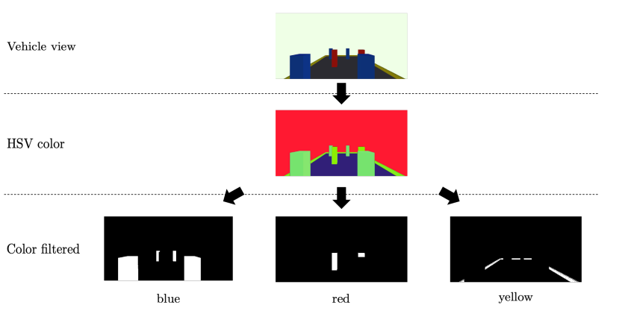
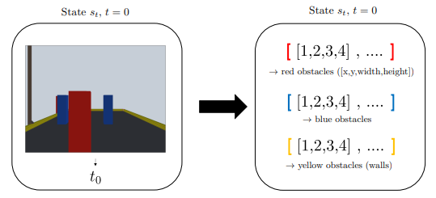
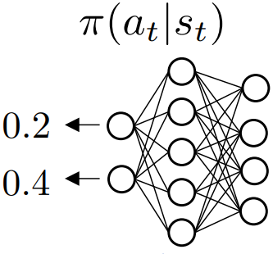
Train an Agent to Drive a Vehicle in a Simulated Environment Using Reinforcement Learning
Notes:
This thesis builds upon the work by Maximilian Schaller
End-goal of Scads.AI is transfer to real-life JetBot
Hand-crafted preprocessing pipeline
Input to the neural network are the bounding box coordinates of the detected objects
Agent was not resilient to light changes
Preprocessing pipeline was the main issue – light changes

Slide 5
Train an Agent to Drive a Vehicle in a Simulated Environment Using Reinforcement Learning
A hand-crafted preprocessing pipeline extracts features from images.
Extracted features of the last n frames are stacked together. (Memory)
Extracted features are used by a neural network to produce two outputs.
Left and right wheel acceleration
Agent struggled with difficult parcours.
Agent was not resilient to light changes.
Notes:
This thesis builds upon the work by Maximilian Schaller
End-goal of Scads.AI is transfer to real-life JetBot
Hand-crafted preprocessing pipeline
Input to the neural network are the bounding box coordinates of the detected objects
Agent was not resilient to light changes
Preprocessing pipeline was the main issue – light changes

Slide 6
Autonomous driving task
Master‘s Thesis

Slide 7
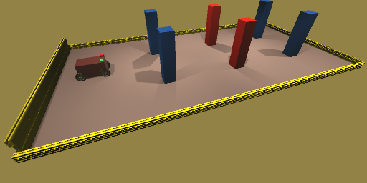
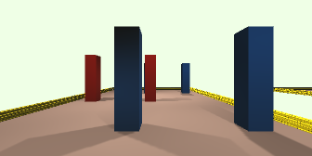
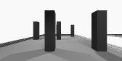
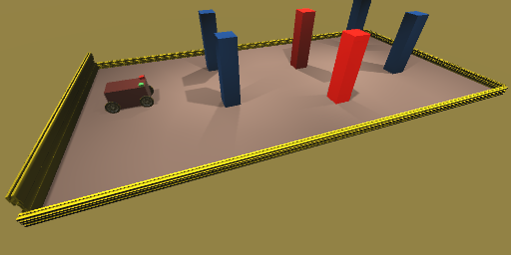
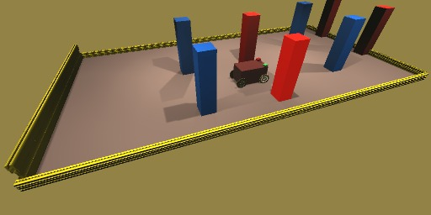
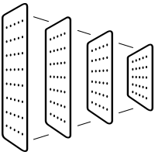
Autonomous driving task
Easy
1. Agent Camera PoV
2. Preprocessing
Medium
3. CNN produces Wheel Acceleration values
4. Agent moves
Hard
Notes:
Describe the task
Describe the agent (wheels plus camera show CAMERA POV)
Different lighting settings
Show parcours of all difficulties

Slide 8
Research questions
Master‘s Thesis

Slide 9
Research question 1
Is it possible to train a Convolutional Neural Network agent with end-to-end Reinforcement Learning to reliably Traverse the parcours of all difficulty levels?
Evaluation:
Pass through the 3 goals without collisions
Fixed lighting
Easy
Medium
Difficult
Notes:
End-to-end RL
Agent mainly consists of CNN

Slide 10
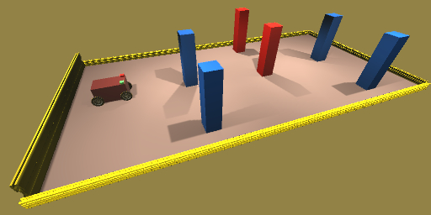
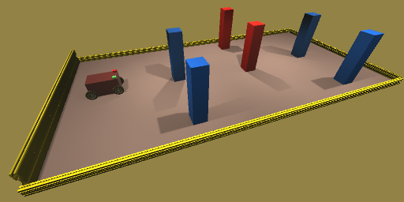
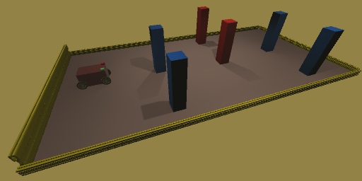
Research question 2
Is it possible to use an end-to-end trained CNN to make the agent robust to changing light conditions?
Evaluation:
Pass through the 3 goals without collisions
Varying lighting
Bright
Standard
Dark

Slide 11
Research question 3
Is it possible to use a CNN which is small enough to be used in the JetBot?
Evaluation:
Create a replay of a successfully completed parcour
Replay consists of input-output pairs
Give inputs to JetBot
Is Output reproduced quick enough by the JetBot?

Slide 12
Related work
Master‘s Thesis

Slide 13
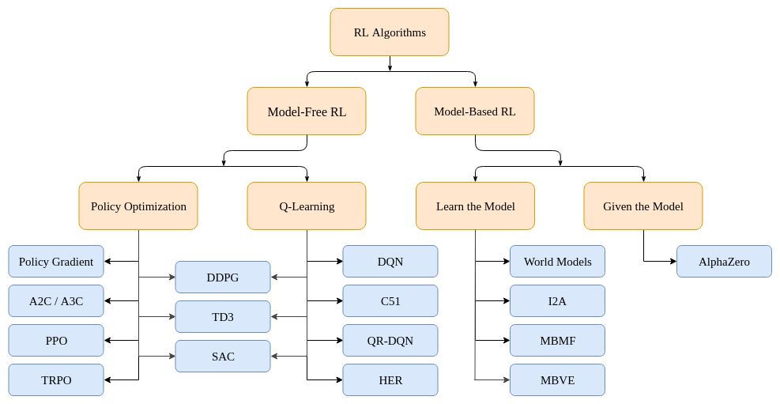
Related work
RL algorithm classification
Notes:
This is not a paper

Slide 14
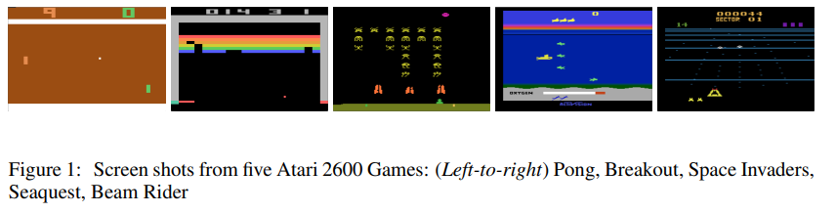
Related work
Playing Atari with Deep Reinforcement Learning
Introduces DQN, an extension of Q-learning
Plays Atari games using convolutional neural networks
Utilized greyscaled and stacked images
Notes:
Breakthrough!
DQN – value-based algorithm

Slide 15
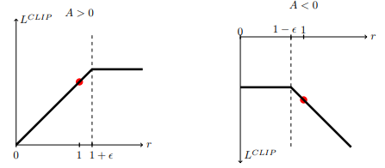
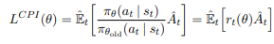
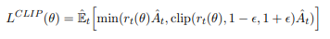
Related work
Proximal policy optimization algorithms
Introduces PPO, a stable and sample efficient policy based approach
Great performance on continuous control tasks
PPO restricts the size of policy updates
Notes:
Breakthrough!
L CPI can lead to extreme updates
L CLIP restricts the size of policy updates
PPO – a stable and sample efficient policy based approach
R_t is the ratio between new and old policy
A is the advantage function, an estimate of the relative quality of actions in the policy

Slide 16
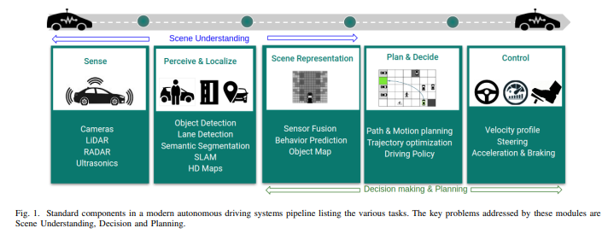
Related work
Deep reinforcement learning for autonomous driving: a survey
Gives a good overview of RL for autonomous driving
Describe modern autonomous driving system pipelines
Describe extensions to RL such as Reward shaping
Notes:
Reward shaping

Slide 17
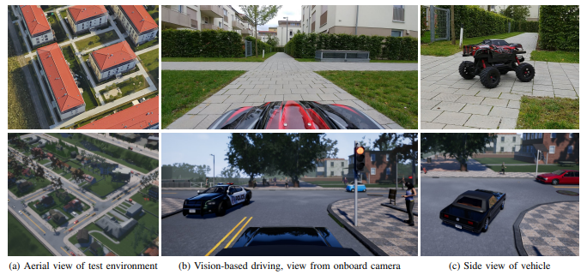
Related work
End-to-end driving via conditional imitation learning
Imitation learning with a convolutional neural network
Extensive use of Data Augmentation
Transformations like changes in contrast, brightness and tone
Gaussian blur, Gaussian noise, salt-and-pepper noise
Notes:
CNN
Data augmentation

Slide 18
Implementation / Methods
Master‘s Thesis

Slide 19
RL Training Algorithm - PPO
s_{t}
Environment
a_{t}
s_{t+1},r_{t+1}
Π(a_{t}|s_{t})
Agent
PPO
Notes:
Describe PPO

Slide 20
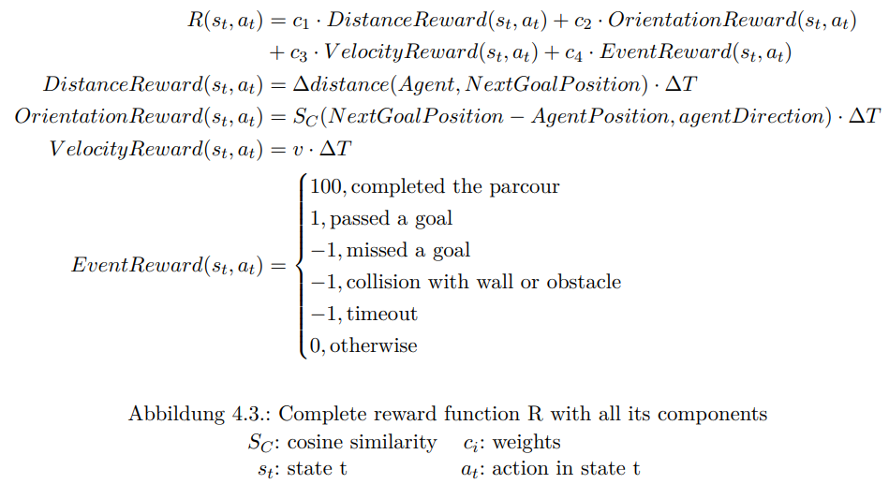
RL Training REWARD FUNCTION
Notes:
Coefficients c have to be determined later

Slide 21
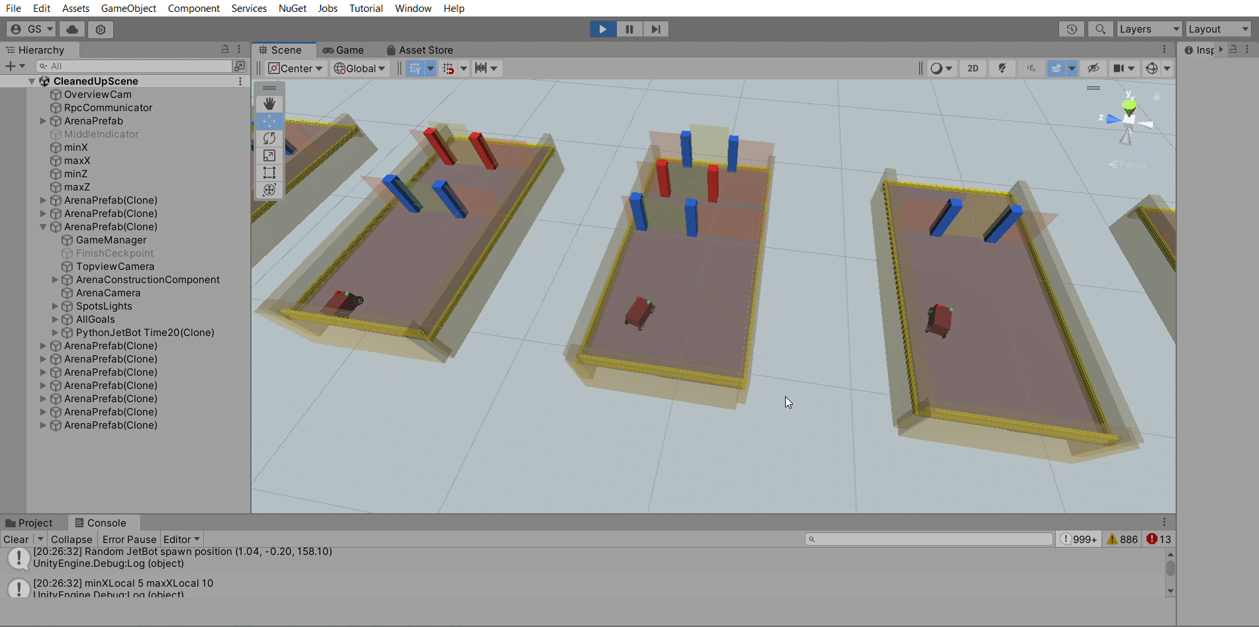
Reinforcement learning training setup
Unity
Python
PPO
-Agent Behaviour
Communication
-Observations
-Rewards
Preprocessing
CNN
Notes:
Describe Unity + sb3 Setup
Mit einem Training Video
Paralleles Training

Slide 22
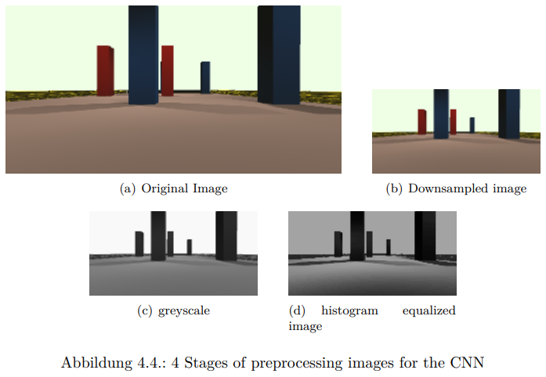
Agent design: preprocessing steps
Notes:
Preprocessing steps reduce the input space size
- Easier generalization
- less processing power required
- requires less memory
Preprocessing steps can help make the agent resilient to light changes
More experimentation needed

Slide 23
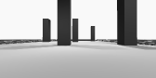
Agent Design: Convolutional neural network
Agent recieves an image at each iteration
Apply image preprocessing steps
concatenate with last n images (memory)
Image stack is fed to a Convolutional Neural Network
Left and right wheel acceleration
Image stack
Notes:
Image stacking serves as a memory

Slide 24
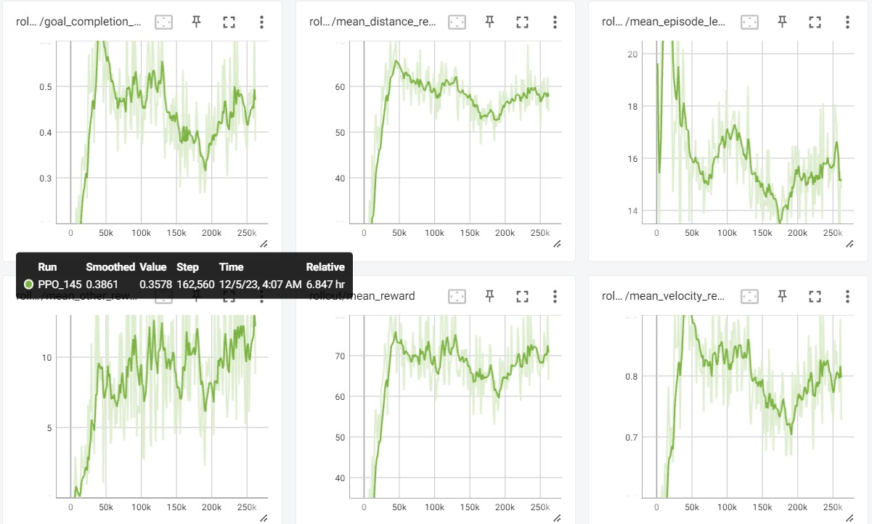
RL Training Monitoring
Logging to tensorboard
Standard and custom measurements
Mean reward per episode
Percentage of passed goals
Percentage of successfully completed parcours
Loss
…
Notes:
Track painting

Slide 25
Experimentation
Master‘s Thesis

Slide 26
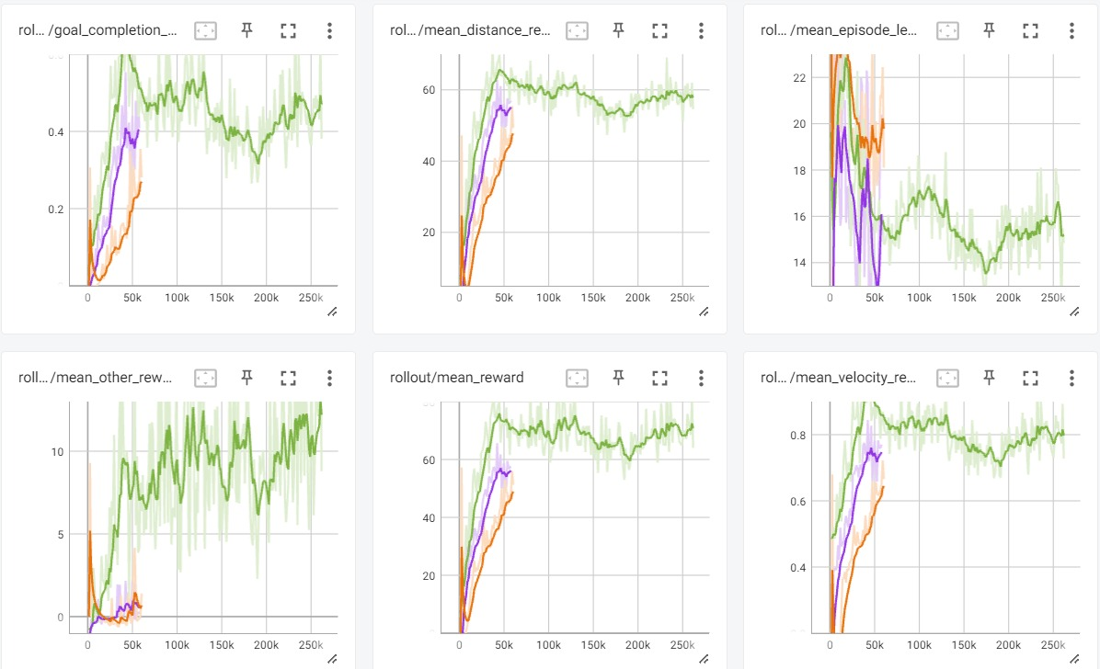
Experimentation
Choice of parameters and preprocessing steps
Network size
Preprocessing steps
Brightness change
Contrast change
Histogram equalization
Reward function weights
Amount of frame stacking (memory)
Notes:
Netzwerkgrößen
Preprocessing Schritte (histogram equalization + andere)
Single Goal vs full map training???
Frame stacking Anzahl
N-step bootstrapping vs plain vs n-seconds bootstrapping

Slide 27
Evaluation
Master‘s Thesis

Slide 28
Agent evaluation - Q1
Agent is evaluated on the three evaluation tracks with standard lighting
Rate of successfully completed attempts
Easy
Medium
Difficult
Notes:
This is specifically for research question 1 and comparison with other light settings

Slide 29
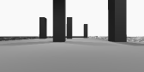
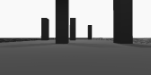
Agent evaluation – Q2
Agent is evaluated on the three evaluation tracks with Varying lighting
Rate of successfully completed attempts
Bright
Standard
Dark
Notes:
This is specifically for research question 1 and comparison with other light settings
Rate of success should not decrease by a lot.

Slide 30
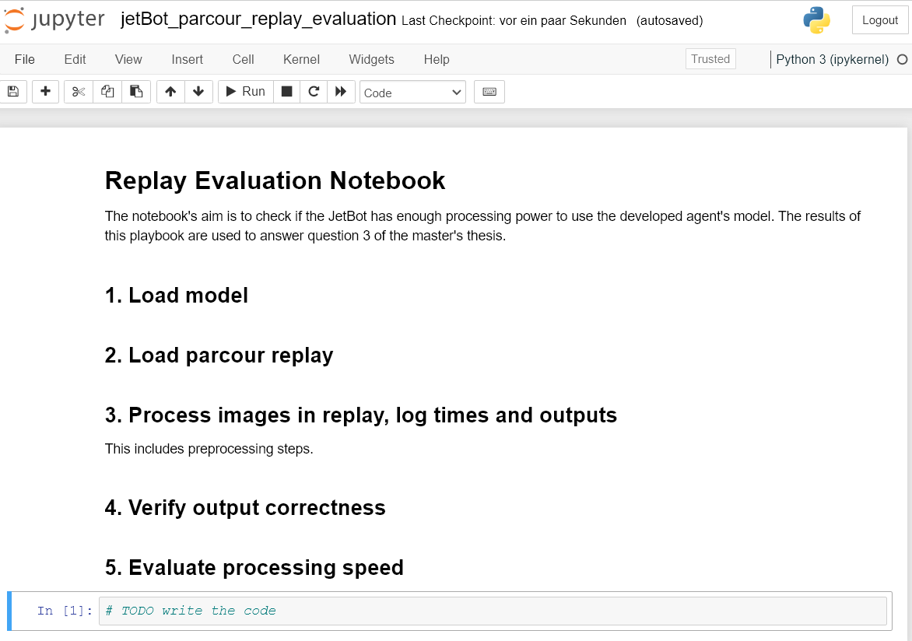
Jetbot processing power evaluation – Q3
Generate Replay of parcour in python and evaluate replay on jetbot
Replay consists of
Input-output pairs
Processing times
Neural Network model
Notes:
Question 3
JetBot processing power should be as fast as the replay

Slide 31
Conclusion
Master‘s Thesis

Slide 32
Conclusion
The thesis investigates training an agent that is resilient to light changes.
Train an autonomous driving agent with Reinforcement Learning
The agent uses a convolutional neural network as its policy
Input is a preprocessed image
Agent is evaluated on tracks of 3 difficulty levels with different light settings

Slide 33
Thank you!
Georg Schneeberger
Faculty of Mathematics and Computer Science
Database Department
g.m.schneeberger@gmail.de
www.uni-leipzig.de

